Slide 1
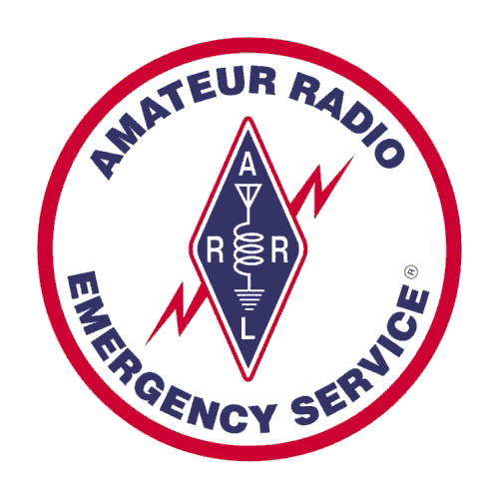


Amateur Radio Support for Healthcare
Santa Clara County ARES/RACES
Michael Fox, N6MEF, RACES Chief Radio Officer
Revised: 13-Mar-2019

Slide 2
Multiple Roles for Amateur Radio
Amateur radio supports many activities and locations during communications emergencies:
  Emergency/Department Operations Centers
  Neighborhood command posts, schools, shelters, hospitals, fire stations, points of distribution, …
For a more general presentation, see:
  “Amateur Radio for Emergency Managers” at
  https://www.scc-ares-races.org/services/emcomm/eoc
Today’s focus: healthcare

Slide 3
Healthcare Communications Flow
Medical info is reported to PHDOC; municipal issues are reported to the city EOC; OA EOC supports both
  Bed status, facility status, resource requests, municipal issues
Amateur Radio:
  Hospital to (PHDOC or City EOC) to OA EOC
  Support for Allied Health facilities is new, workflows developing
Hospital
Public Health
Dept. Operations Center
Amateur Radio
OA EOC
Amateur Radio Operator
Amateur
Radio
Operator
Allied Health
?
City EOC
Amateur Radio
Amateur Radio Operator

Slide 4
Current Projects - Healthcare
High-speed network connectivity
Hospital equipment survey & recommendations
Healthcare forms for radio transmission
Credentialing for healthcare
Allied health outreach & initial connectivity

Slide 5
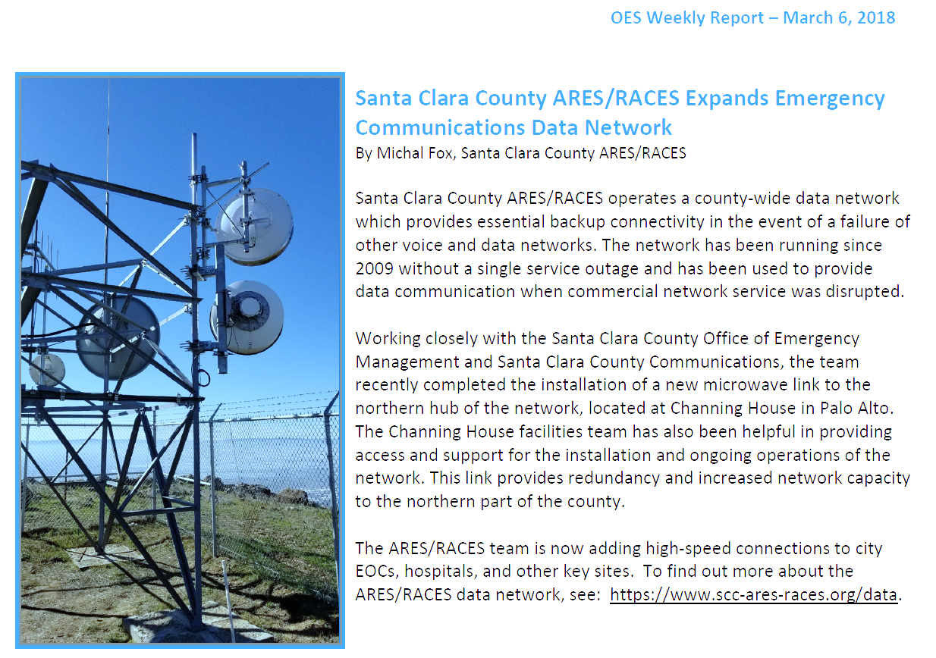
High Speed Connectivity

Slide 6

High Speed Connectivity (2)
County-wide amateur radio data network since 2009
  Low speed, countywide coverage; independent of Internet
  Four separate Internet gateways (when Internet is available)
  No service outage since 2009
  Operated during Loma Fire when commercial carriers didn’t!
  For more info: https://www.scc-ares-races.org/data
All EOCs & hospitals are equipped (to varying degrees)
Last few years: upgrade to high-speed backbone
  Redundant links, redundant sites
  No single link or site failure breaks backbone connectivity

Slide 7
High Speed Connectivity (3)
Now: adding high-speed access to EOCs, hospitals
Services available:
  Packet radio
    Higher speed access to existing data service (like plain-text email)
  Countywide e-mail
    Four redundant, internal e-mail servers (compatible with standard e-mail)
    Can operate independent of Internet if needed
    Four separate e-mail gateways to Internet (when Internet is available)
  Countywide Intranet
    Share files, images, between hospitals, MHJOC, EOCs, …
  Internet connectivity
    Four separate Internet connections
Important: By law, we can’t/don’t compete with commercial providers of these services
  Use for backup during communications emergencies
Next step: determine individual site needs …

Slide 8

Hospital Equipment Surveys
Outcome of 2018 Statewide Medical Health Exercise
  Amateur radio equipment readiness varies by hospital
  Some existing equipment needs to be replaced
  Most hospitals missing some essential functionality
Created Hospital Command Center recommendations
  General radio capability recommendations:
    https://www.scc-ares-races.org/operations/hcc-nets.html
  General equipment recommendations:
    https://www.scc-ares-races.org/operations/hcc-equip.html
Action Item in Improvement Plan
  Survey and prepare an equipment plan for each hospital

Slide 9
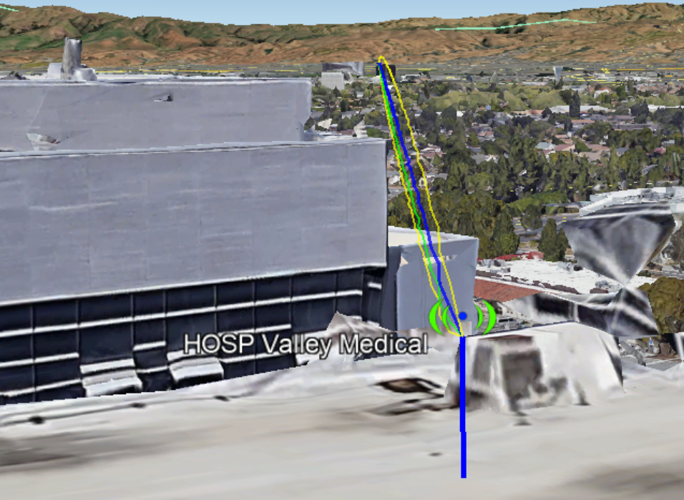
Hospital Equipment Surveys (2)
Survey Status
  Evaluating high-speed radio line of sight paths
    Signal strength, antenna recommendations, …
  Started individual hospital surveys
    Survey existing equipment; identify gaps; list recommendations
    So far: Valley Medical, O’Connor, St. Louis
  Target date to complete all hospitals: June, 2019
Example:
Line of sight radio path between Valley Medical
and San Jose hub

Slide 10
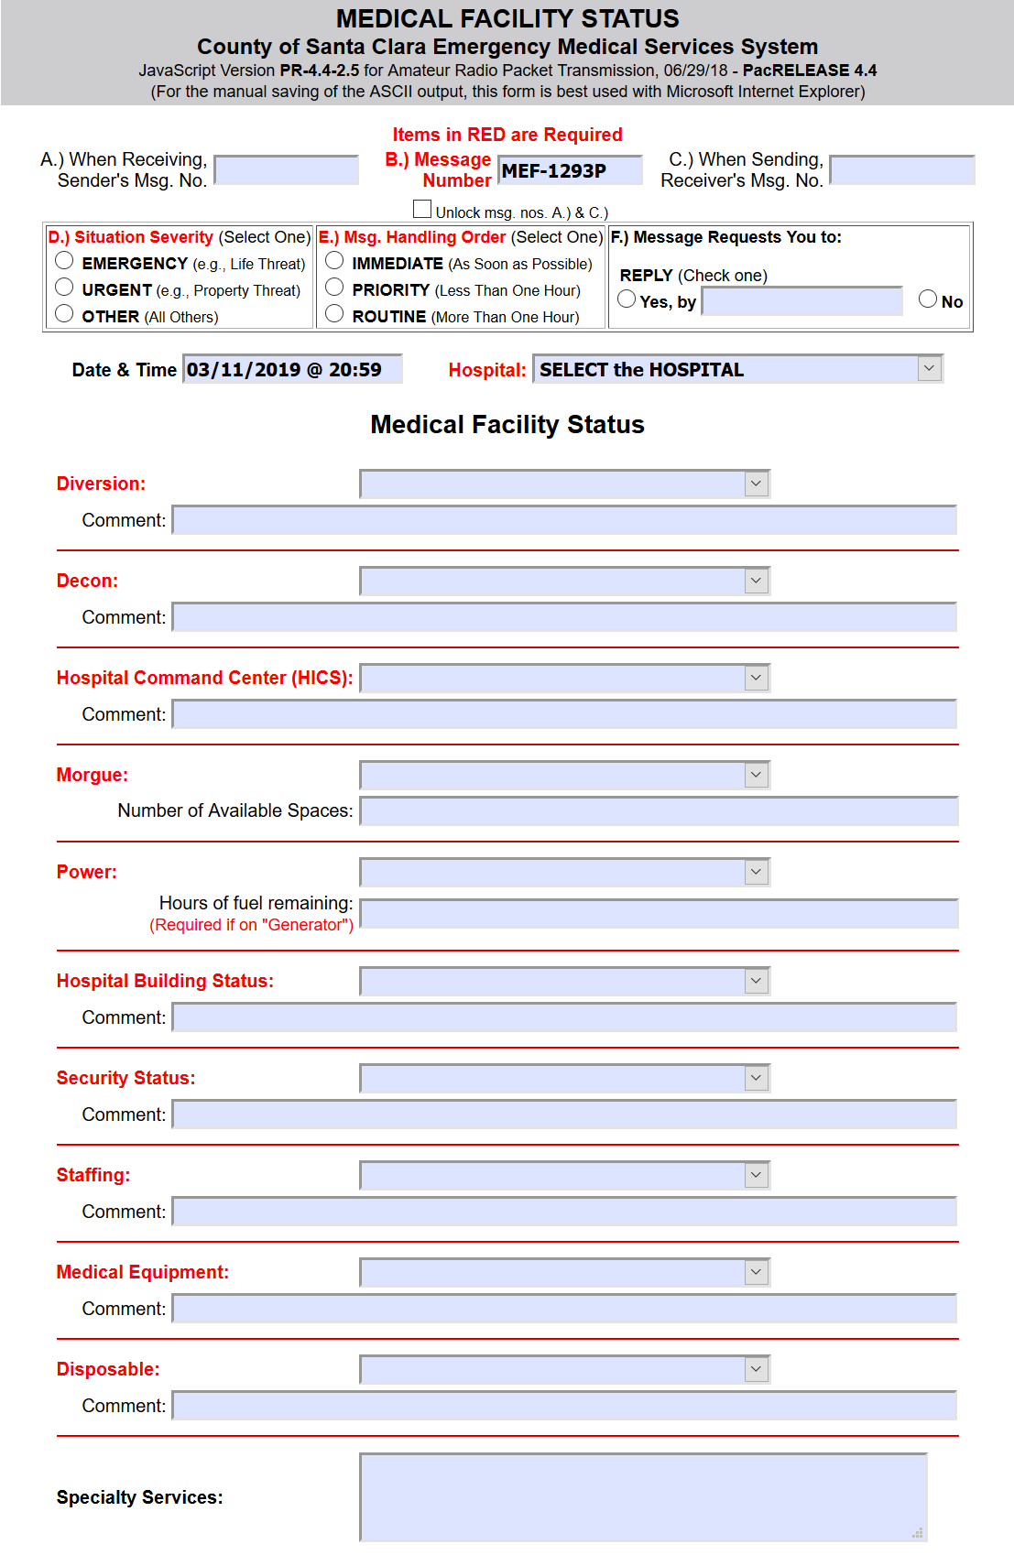
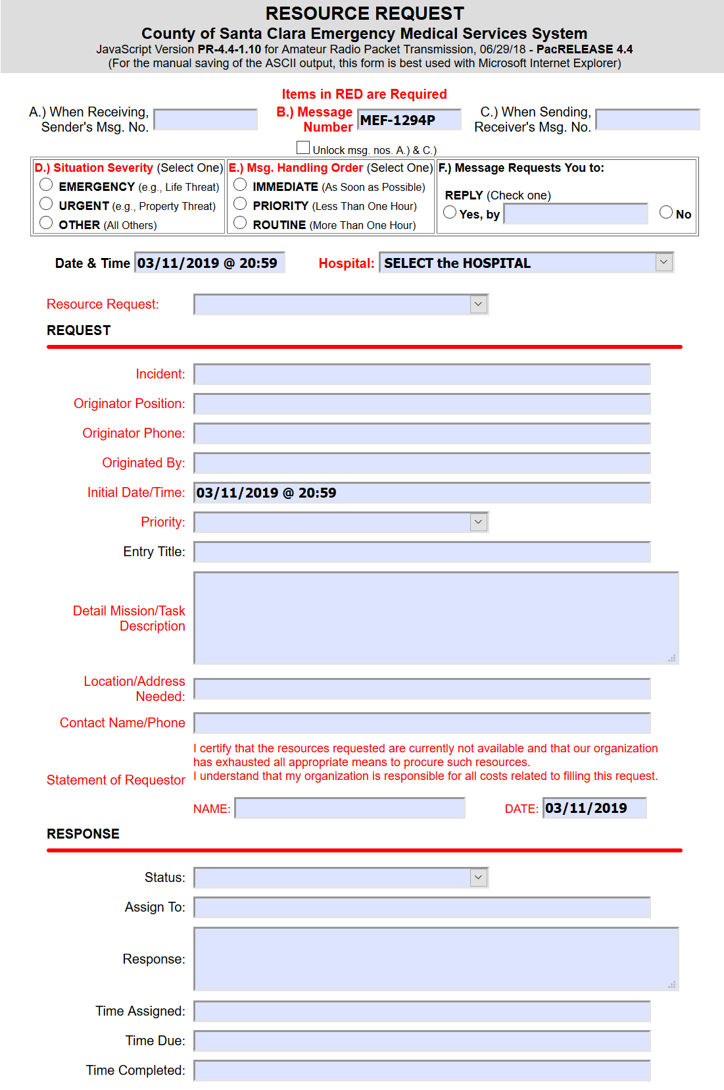
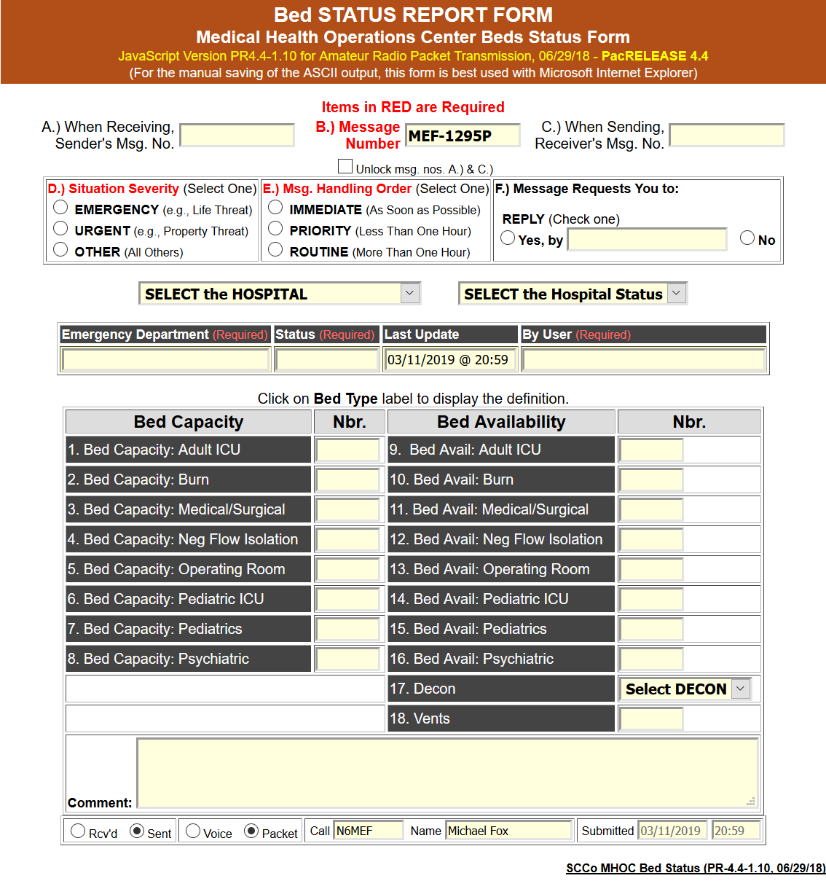
Healthcare Forms
Complex healthcare status forms can be sent via low-speed VHF radio when necessary
  Used during 2018 Statewide Medical Health Exercise
Currently updating these forms for better alignment with look and feel of forms in WebEOC, EMResource

Slide 11

Credentialing for Healthcare
Outcome of 2018 Statewide Medical Health Exercise
  Amateur radio operator readiness varies by hospital
  Need standard for more consistent capability
Action Item
  Leverage existing county Mutual Aid Communicator credentialing program
    Started in 2009; highly successful; copied by many
    Updating program to cover more than mutual aid situations
    Healthcare agencies will be able to request credentialed operators at the city level
  Currently investigating healthcare-specific requirements
    Security, training, …
  Target: Summer 2019

Slide 12

Allied Health Outreach
New, developing …
Working on definition of info/work flow via amateur radio
Prepared very basic equipment recommendations
  https://www.scc-ares-races.org/operations/allied-health-equip.html
  In most cases, an antenna on the roof is a great start
Healthcare-specific licensing classes held
  https://www.scc-ares-races.org/training.html#license
Summary email with links to local city amateur radio leaders
  https://www.scc-ares-races.org/cities.html
Some outreach has begun; some meetings held
If you’re ready to get started, don’t wait. Give your local amateur radio leader a call!

Slide 13
Summary
Major focus this year on improving amateur radio preparedness at healthcare facilities
  Network capacity
  Hospital equipment
  Forms processing
  Operator capability
  Outreach to / integration with allied health agencies
For more info:
  https://www.scc-ares-races.org
For a copy of this presentation:
  https://www.scc-ares-races.org/services/emcomm/healthcare

